Slide 1
GEHC SDT Weekly Status Report
03/02/17

Slide 2
Open Actions
Action item | Owner | Forum | Expected Closure Date | Actual Closure Date | Owner Comment | Status
Mobility Team or tiger team to be formed to resolve all CLICK mobile issues. | Rohit/Gopi | Jan’ 17 Workout | TBD |  | Few next steps have been identified for further analysis. | In Progress
Performance issues: SDT Booking and Architecture Assessment. | Hita/Andrey/Urmila | Jan’ 17 Workout | 28-Feb-2017 |  | Logging mechanism is implemented and tested. | In Progress
Ownership on Tickets/Process adherence(Agile Mechanism) | Suvarna/Sathyaraj | Jan’ 17 Workout | Ongoing |  |  | In Progress
GEHC to share nonfunctional requirements | Chandra | Jan’ 17 Workout | TBD |  | Few are identified from Rally | In Progress
GEHC to check and confirm on L1 support - on call support | CG | Jan’ 17 Workout | TBD |  | CG team confirmed to go for On call support to GE | In Progress
CLICK DB access for CG team GE to setup a separate call to discuss | Chandra | WSR meeting | TBD |  |  | Open

Slide 3
Weekly Snapshot – 03/01/17
Health of the Engagement
Highlights
CLICK R2.1 & R2.2 Successful deployment on Prod for APAC.
CLICK R2.1 & R2.2 Successful deployment on Sandbox 1 & Stage for Europe.
R1.3 Master data load on Prod.
Technical User stories planned and created w.r.t Performance Assessment for the next SPRINT.
Testing : Testing is completed for US85 (ES and LS) functionality.
Updated the script “OQ_SR_Desc_ES_LS_Same” as per current scenario and uploaded in Rally.
Developed tool to pass the SIEBEL parameters wherein testing can be done on variable data inputs.
GREEN
Risk / Issues / Challenges
Help Needed
Click DB access(Prod, Stage, Sandbox) for Gopi & Preeti
Subsequent cancelling of Backlog grooming of functional user stories sessions may impact Sprint planning activities.
Need resolution to infrastructure related queries and common forum to resolve.
Need support on performance related issues on CLICK side.
Need help from CLICK team on Debug log and Environment details for further analysis on Mobile sync issue.

Slide 4
Focus Area Updates
Focus Areas | Owner | Status | Comments
Mobile Sync Issues | CG Team | In Progress | CLICK team to provide debug log and end to end environments details. As part of Patch 10, R 2.1, R 2.2 and SDT 2.4 13 mobile sync issues are resolved. Here are few next steps identified from Tiger and Mobile iron team discussions: Involve functional team. Share test SSO’s with MI, SSO and Click team. Try to capture logs for FEs SSOs on MI and SSO. Analyze the logs for any new ticket raised.
SDT Booking Performance Issues | CG Team | In Progress | Few newly identified performance improvement related points in SDT : Use Database for frequently used parameters(Site, System and Status). Parameter Indexing is missing in click functions. SDT code logging mechanism improvement is identified and implementation is completed. Queries are pending regarding architecture assessment with network team.
Release Management | CG Team | Ongoing | Release check list was created and it is updated in our Release readiness check call.
Incident Management | CG Team | Ongoing | Streamlining incidents w.r.t CLICK support cases Problem ticket creation process finalized. Incidents reported in this week are closed.
Support and Development Process streamlining | CG Team | Ongoing | Agile metrics identified and tracked through Rally. Ensuring all email communication to have incident ticket created. Internal defect tracker is maintained to track the QA/UAT defects and owners defined for each defect.

Slide 5

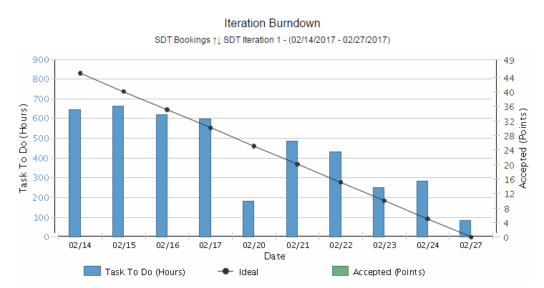
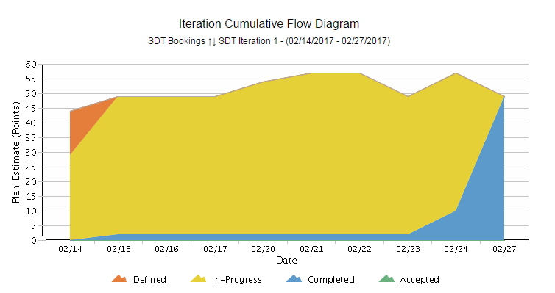
Agile Metrics
SDT Development Release 1.4 Iteration 1 14th Feb to 27th Feb ‘17
Iteration Burndown Chart:
Smooth flow at the start: TO-DO meets the ideal line at few points in the start of the sprint.
Variations in TO-DO in the middle:
Tasks keep on added up in the middle of the sprint.
At the end of sprint we are done with all the user stories expect sprint review.
Iteration Cumulative Flow Diagram
All the user stories are completed at the end of the current sprint.
Inferences
Inferences
Inferences

Slide 6
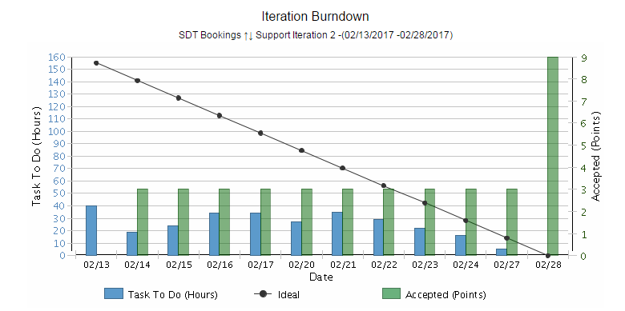
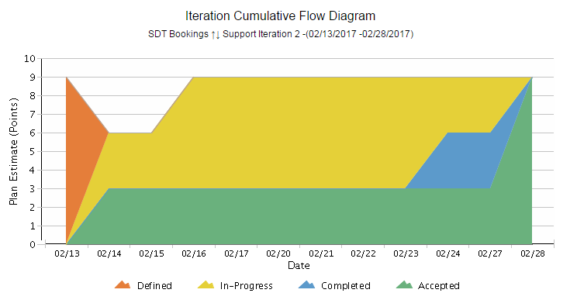
Agile Metrics
SDT Click, Support and Incidents
Iteration Support Burndown Chart:
Support activities keep on added up on a daily basis based on the support tickets that we receive. Hence there’s a mismatch with ideal.
End of the sprint, all tickets are closed and most of the user stories are accepted by Product owner.
Iteration Cumulative Flow Diagram
All the tickets and user stories related to Release 2.1 ,2.2 and R1.3 are completed and accepted by Product owner.
Inferences
Inferences
Inferences

Slide 7
Incident Update
13 incident tickets are resolved/closed
8 Awaiting 3rd party - Mobile Issues
3 Awaiting User Info
Inferences

Slide 8
Incident Tickets
Incident Management
Incident # | Module | Key Words | Status | Problem #
INC1370193 | SDT Mobile | Mobile sync Issue | Awaiting 3rd Party | NA
INC1435961 | SDT Mobile | Mobile sync Issue | Awaiting 3rd Party | NA
INC1447060 | SDT Mobile | Mobile sync Issue | Awaiting 3rd Party | NA
INC1447037 | SDT Mobile | Mobile sync Issue | Awaiting 3rd Party | NA
INC1446914 | SDT Mobile | Mobile sync Issue | Awaiting 3rd Party | NA
INC1454094 | SDT Mobile | Mobile sync Issue | Awaiting 3rd Party | NA
INC1463913 | SDT Mobile | Mobile sync Issue | Awaiting 3rd Party | NA
INC1464027 | SDT Booking | Click Issue | Awaiting User Info | NA
INC1477114 | SDT Booking | Mobile Sync Issue | Awaiting User Info | NA
INC1480941 | SDT Mobile | Mobile Validation Issue | Awaiting 3rd Party | NA
INC1480772 | SDT Mobile | Mobile sync Issue | Awaiting User Info | NA
Problem Management
Problem # | Module | Keyword | Status | Incident #
PRB0045855 | SDT Booking | Google API | Open | INC1371682, INC1389372, INC1357120
PRB0045895 | SDT Booking | Email Activity | Open | INC1285226
PRB0045475 | SDT Booking | Performance - Connectivity | Known Error / Pending CA | INC1310582

Slide 9
THANK YOU

